Slide 1


CAR RENTAL SYSTEM
Under the guidance of
Mr. Arpit Jain
1) Sharad Dilip Kute (220910120045)
2) Morane Rakesh Pandharinath (220910120033)
3) Dhage Manisha Sahebrao (220910120017)
4) Vikas Pandey (220910120056)
PG DAC (Sept 2022) Group-11

Slide 2
■ The Car Rental System is being developed for customers so that they can book their cars from any part of the world. ■ This application takes information from the customers through filling their details. ■ A customer being registered in the website has the facility to book a Car which he requires. ■ The proposed system is completely integrated online systems. It automates manual procedure in an effective and efficient way. ■ This automated system facilitates customer and provides to fill up the details according to their requirements. ■ This software car Rental System has a very user friendly interface. Thus the users will feel very easy to work on it. By using this system admin can manage customer confirm and cancel booking request, ■ The car information can be added to the system. Or existed car information can be edited or deleted too by Administrator. There is no delay in the availability of any car information, whenever needed, car information can be Captured very quickly and easily.
Abstract

Slide 3
Introduction
This Car Rental System project is designed to aid the car rental company to enable renting of cars through an online system.
It helps the users to search for available cars view profile and book the cars for the time period.
It has a user-friendly interface which helps the user to check for cars and rent them for the period specified.
Along with that user can also hires driver for their ride.
The use of internet technology has made it easy for the customers to rent a car any time.
The tool shall ask the user for information such as the date and time of journey, type of car etc. Using these details, the tool shall help the customer to book a car for the journey.
After completion user can also share there feedback for futuristic betterment.

Slide 4
Objectives
• To reduce the effort of booking a car in a conventional procedure.
• To ease the search process of a customer who is in need of a car.
• To provide services to the customers in order to achieve the best customer satisfaction.
• Users who cannot drive or do not have driver license can rent cars with our drivers.
• Admin can manage the car catalog by adding or removing cars based on their availability.
• Reduced errors with rental data effectively stored in database.
• Entire network works on one single platform, seamless flow of data.
• Standardization of processes and services ensure clients receive the correct rates.

Slide 5
NEED OF PROJECT
A car rental is a vehicle that may be rented for a price and utilized for a specific length of time.
Getting a rental automobile makes it easier for people to travel around when they don't have access to their own vehicle or don't own one at all.
A person who needs transportation must call a rental car company and sign a contract.
This method improves client retention while also making car and Employee management more straightforward.
To ease the search process of a customer who is in need of a car.

Slide 6
Specifications Of System
■ Admin: Admin is the super user of the website who can manage everything on the website except booking.
■ Users: Anyone can register through the registration page. After a successful registration user can log in with valid username and password.

Slide 7
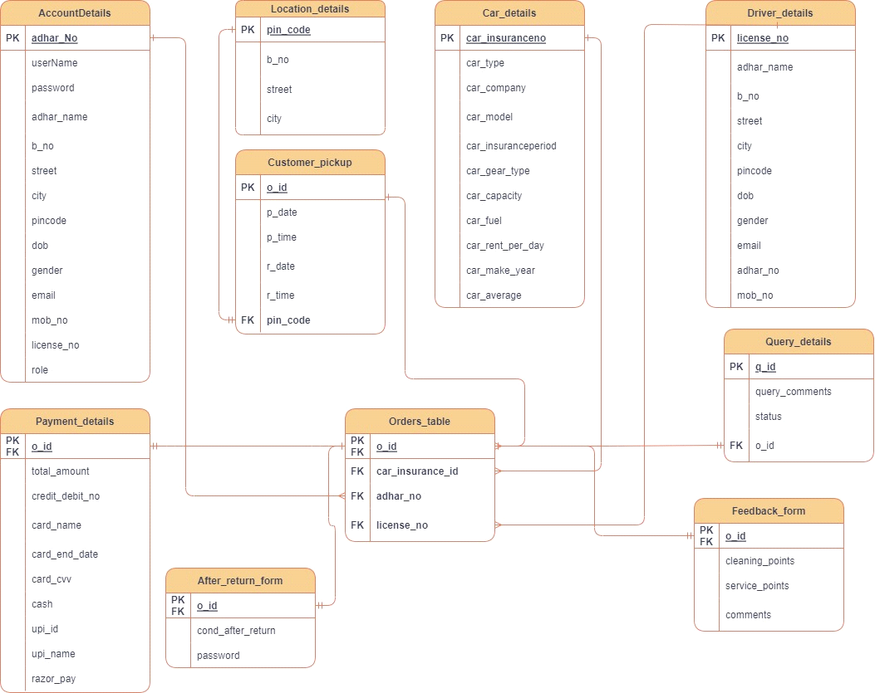
Entity Relationship Diagram

Slide 8
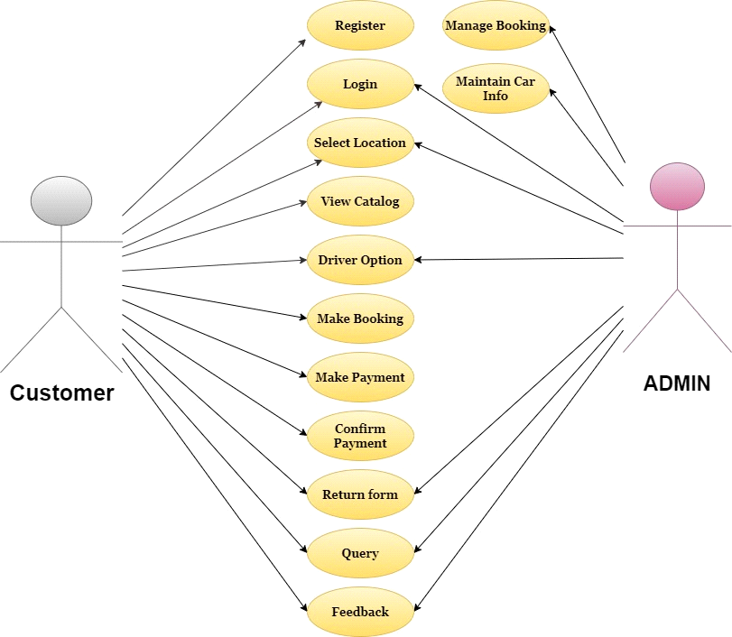
Use case Diagram

Slide 9
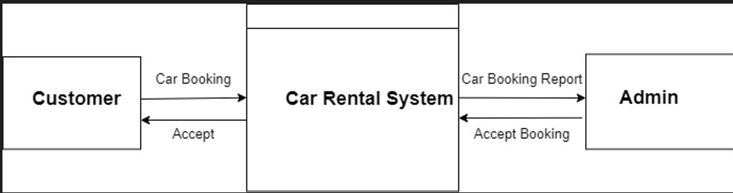
Dataflow Diagram

Slide 10
Technology Used
Front End: HTML5 ,React Js,bootstrap5, CSS3
■ Springboot
MYSQL 8.0
IDE:Spring Tool Suite 3

Slide 11
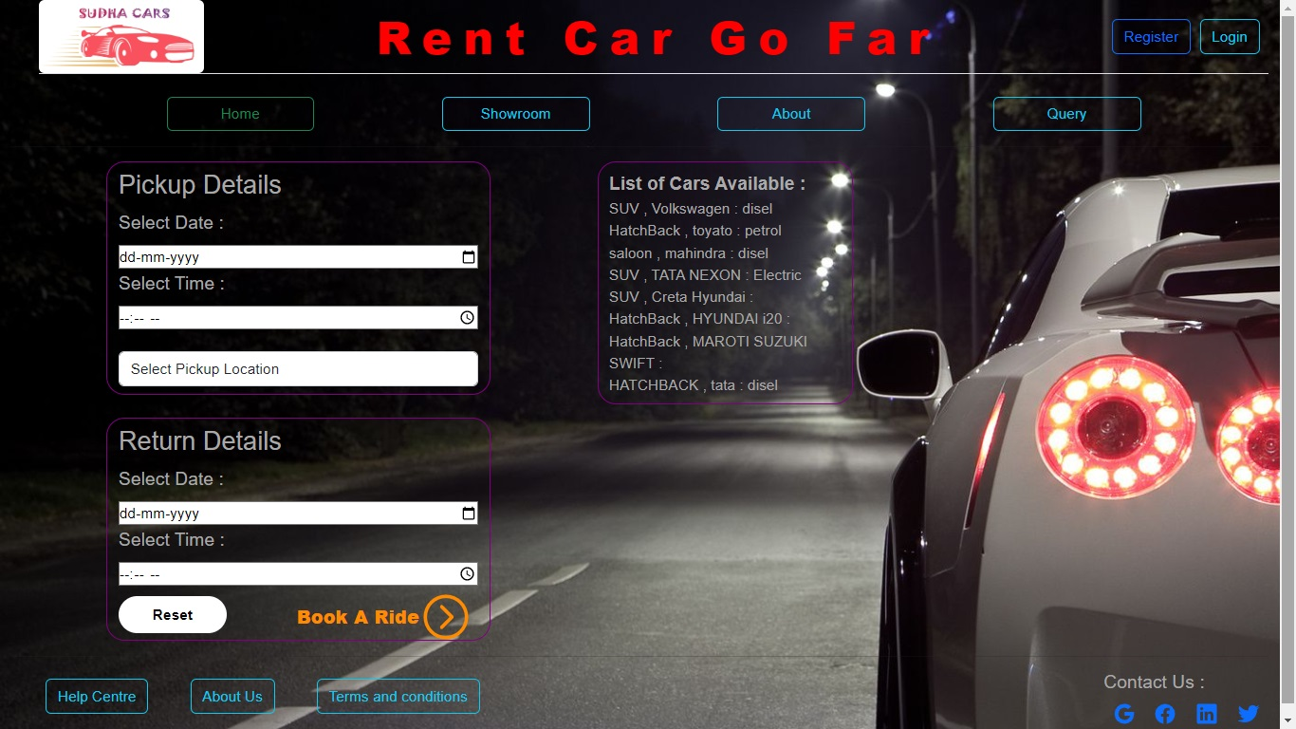
Home Page

Slide 12
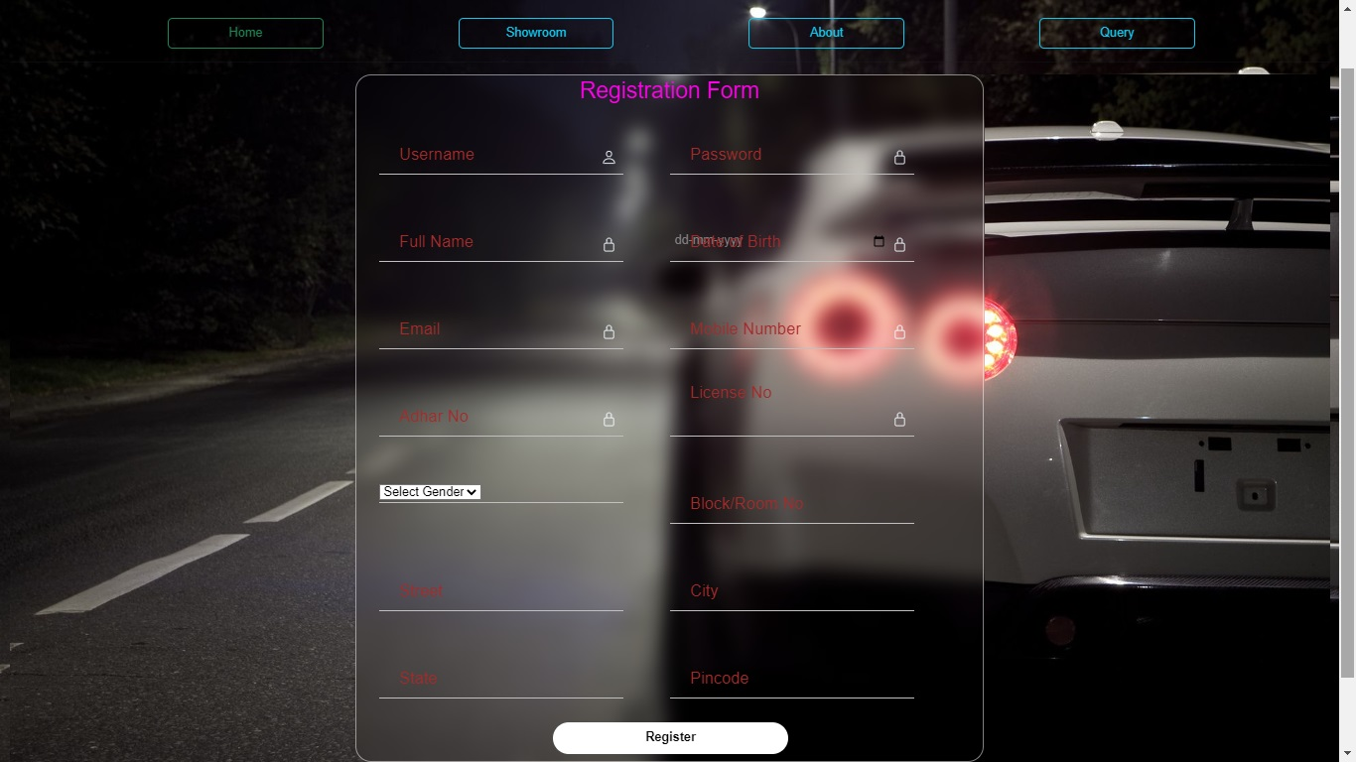
Register :
Registration Page

Slide 13
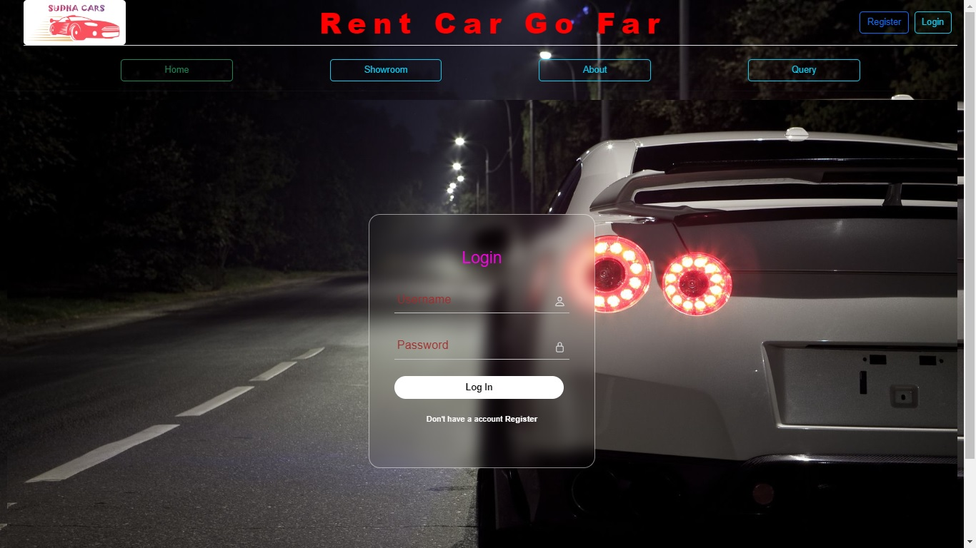
Login page

Slide 14
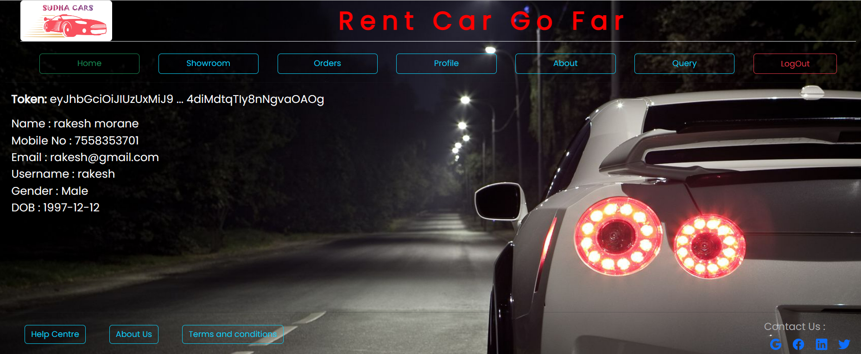
User Profile

Slide 15
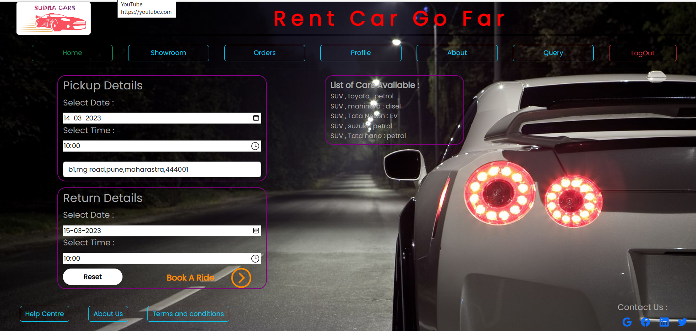
Pickup Details

Slide 16
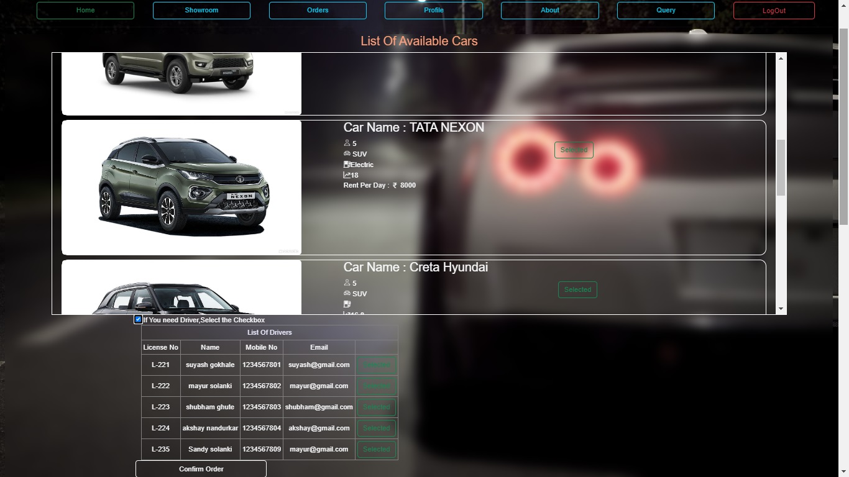
Car Section

Slide 17
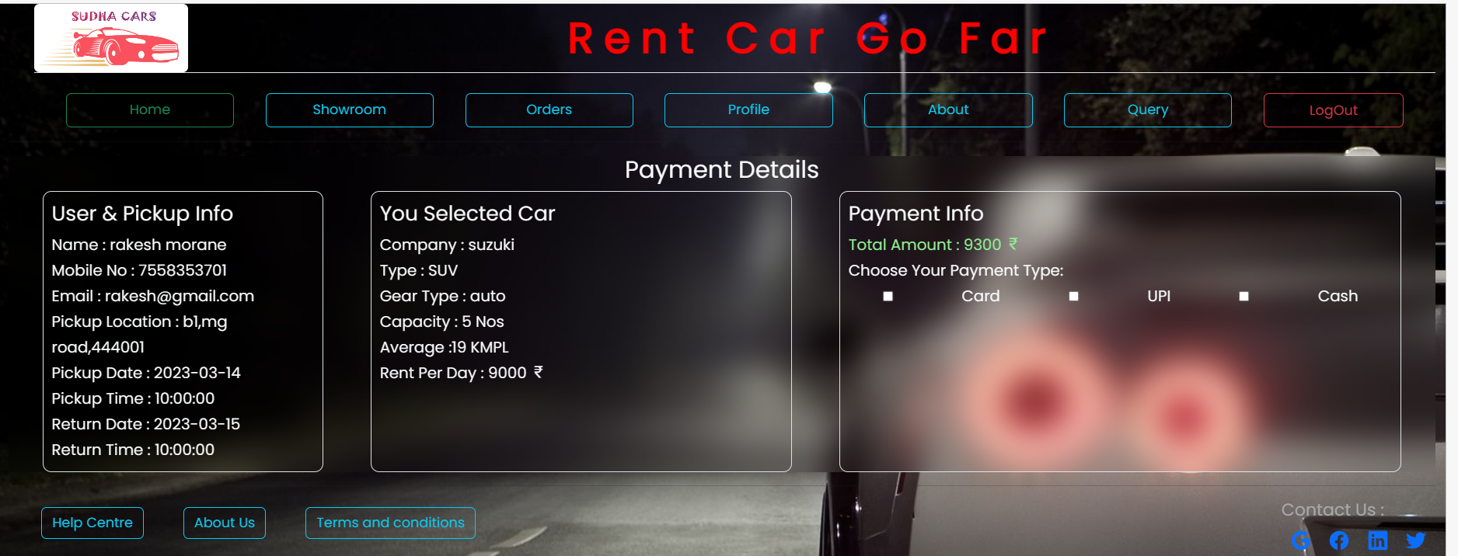
Payment Details

Slide 18
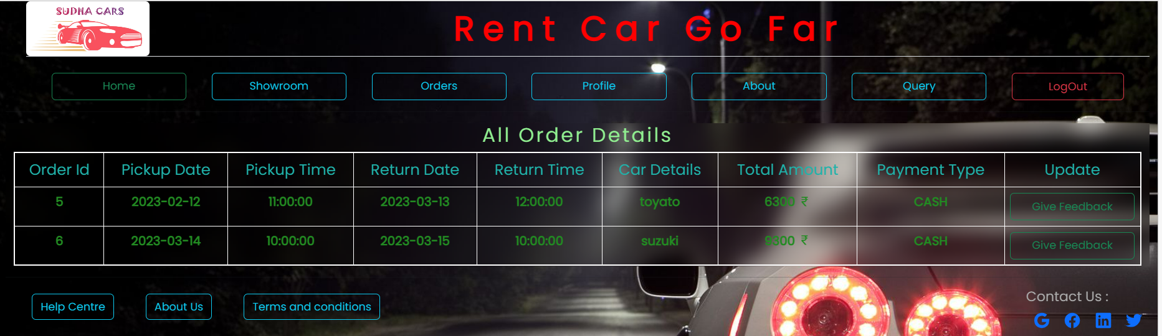
Order Details

Slide 19
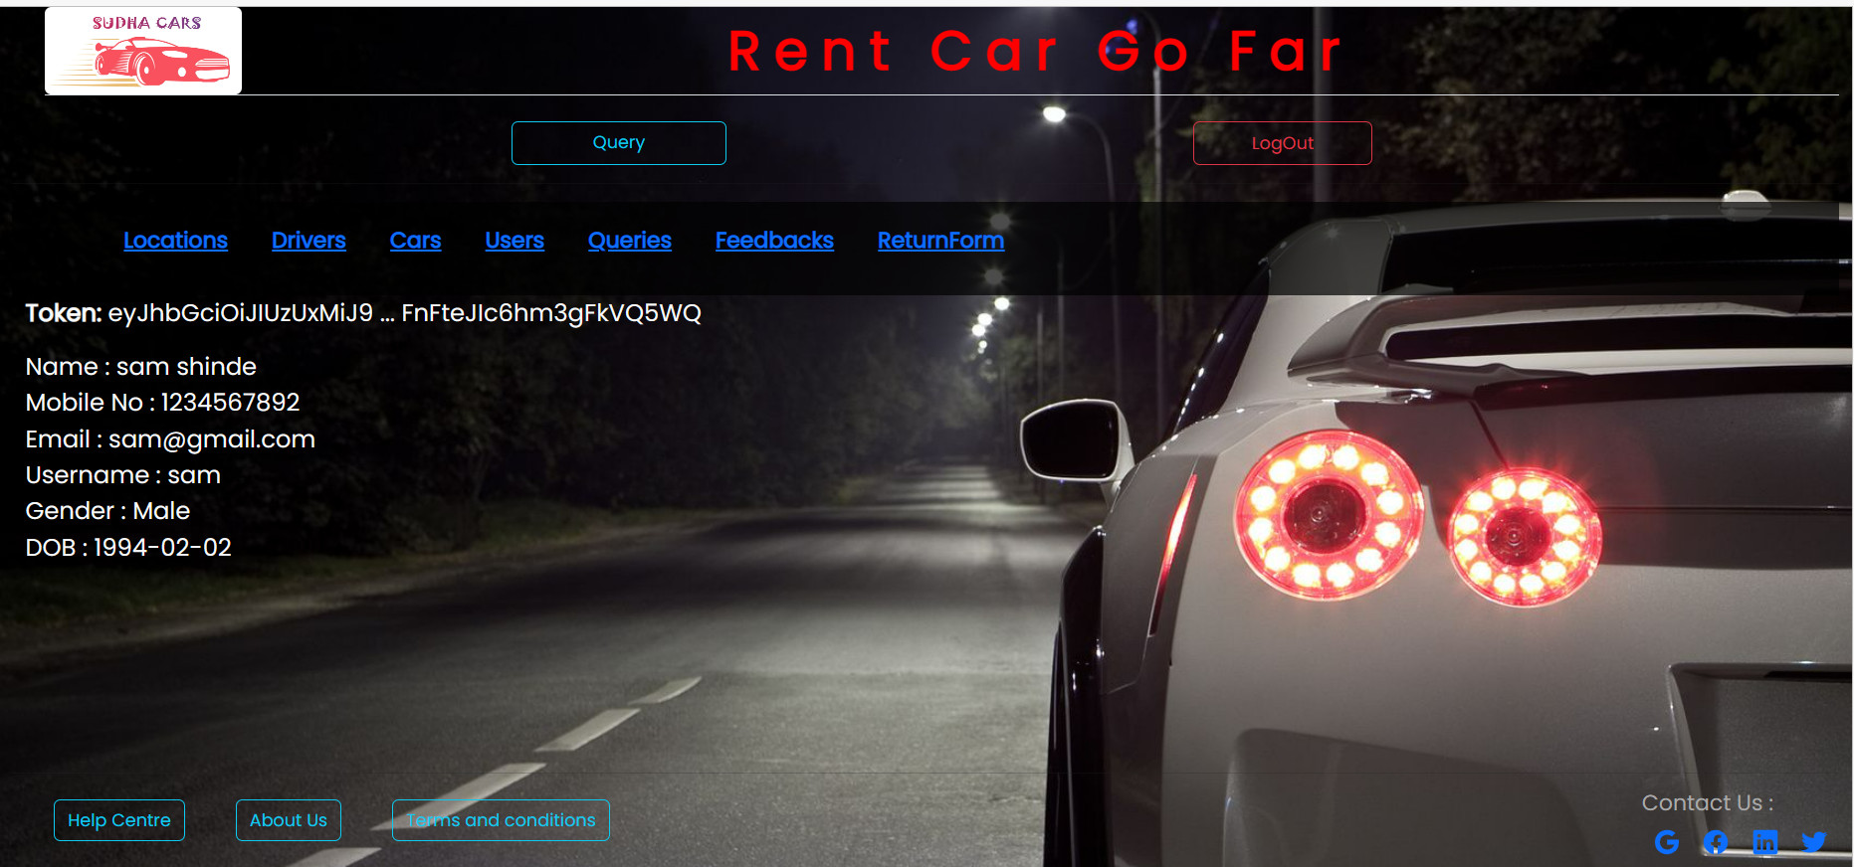
Admin

Slide 20
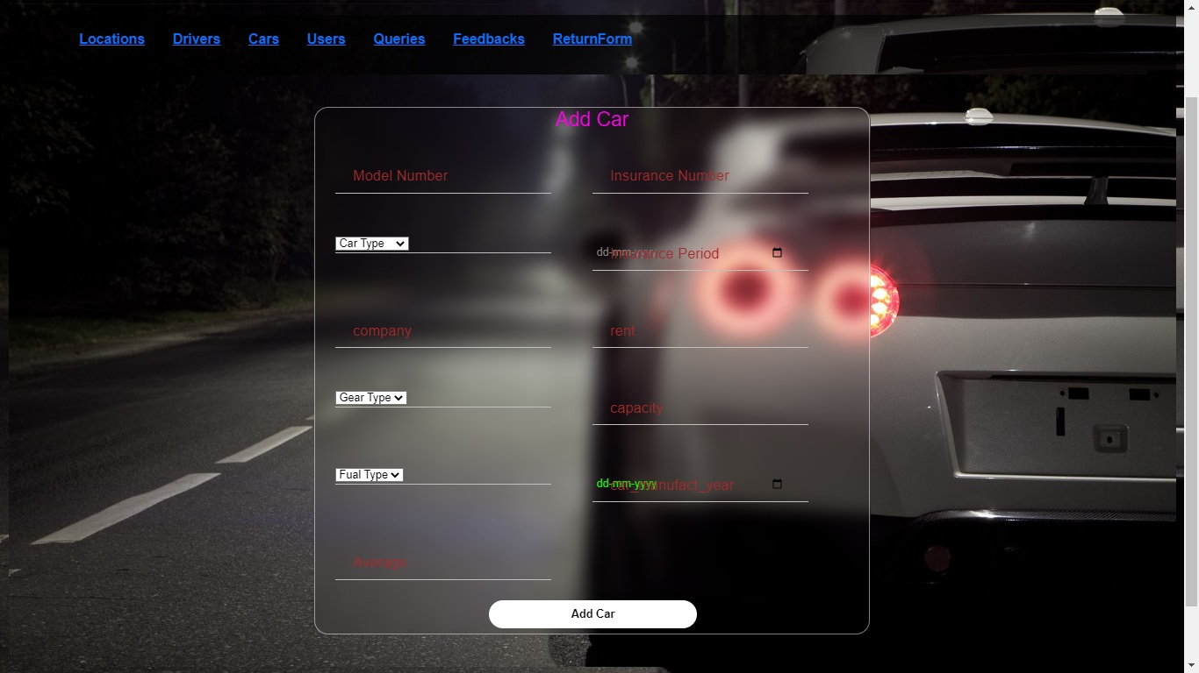
Add Car

Slide 21
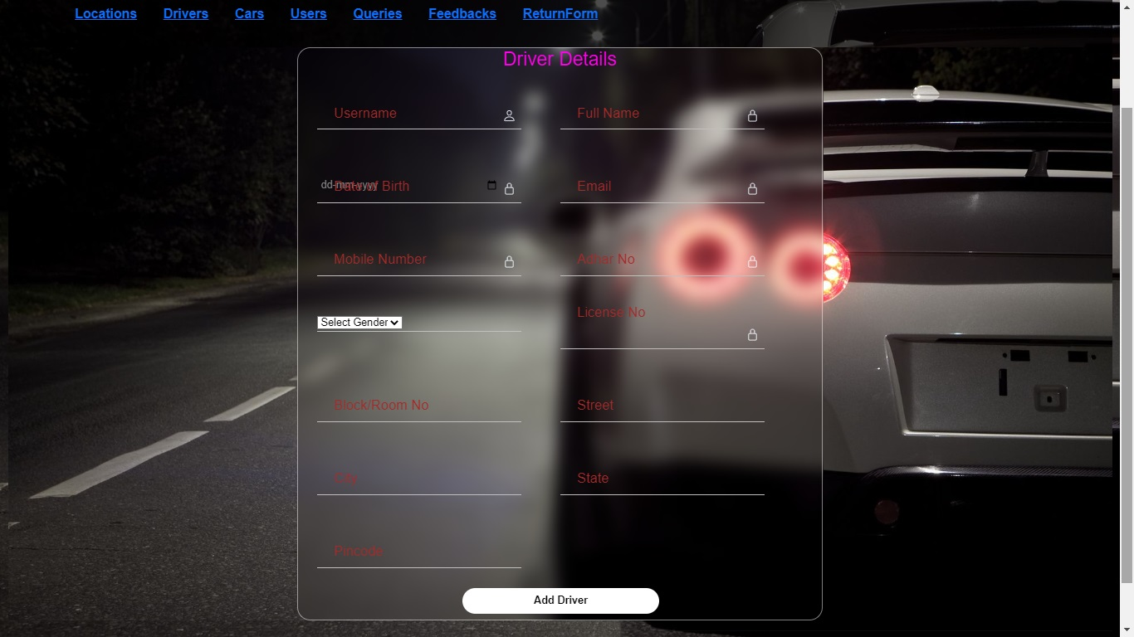
Add Driver

Slide 22
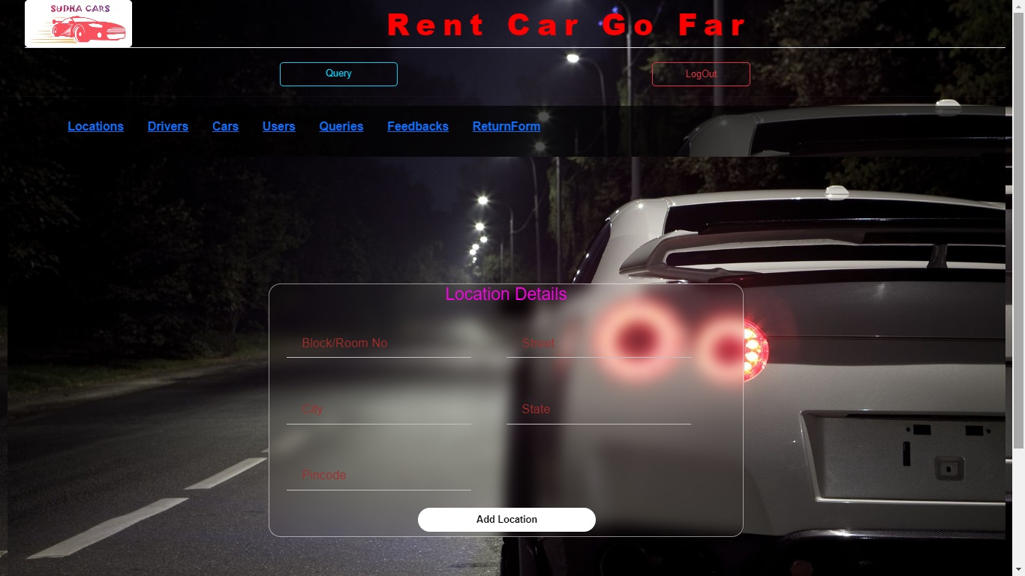
Location Details

Slide 23
1) Taking advantages of the local marketing 2) Make online Bookings more user friendly 3) Competition with the car sharing industry 4) Contend with fleet management issues 5) Customer service will be more important than ever 6) Enhancing Digital Marketing Efforts.
Future Scope

Slide 24
Conclusions
The solution was to provide car Rental with an user-friendly web application that would allow for customers to access and use on a wide range of devices: desktops, laptops, mobile devices, tablets.
The website is designed to stay up to date by giving administrators the ability to change/add/remove any featured vehicles on the site.
The website will verify and store any information the user may input when making a rental purchase request.
This will appear in real time onto the software used by the employees.
This software provides an easy-to-use interface to allow for simple access to rental requests and gustomer information.

Slide 25
THANK YOU!!

